Slide 1
What is jQuery Mobile?
jQuery mobile is a framework created for making platform independent mobile applications using HTML5, CSS3, and jQuery.
See: http://www.codeproject.com/Articles/644118/Writing-your-first-jQuery-Mobile-app-Part
jQuery Mobile can help in the following circumstances:
Different screen sizes, pixel densities (DPI) and orientations;
Different compatibility in terms of HTML5 and CSS3;
New platforms appearing every couple of months;
Dozens of hacks that we need to implement for each platform and to update almost every couple of months when a new browser appears.
See: https://www.smashingmagazine.com/2013/03/getting-started-jquery-mobile/

Slide 2
jQuery Mobile is not really related to jQuery!
They chose that name to tag along with the widespread use of jQuery. jQuery Mobile does use jQuery, but that’s the only connection.
jQuery is a lightweight, "write less, do more", JavaScript library to make it easier to use JavaScript code.
Query takes a lot of common tasks that require many lines of JavaScript code to accomplish, and wraps them into methods that you can call with a single line of code.
jQuery also simplifies a lot of the complicated things from JavaScript, like AJAX calls to server and DOM manipulation.
The first line of the library says $ = jQuery; so you will see lots of code with this $ showing up, its just a short synonym for jQuery
Common example is, instead of typing
Var inputString = document.getElementById ("firstname").value
var inputString = $("# firstname ").val();
It uses “id” # class . and element <p> identifiers that are exactly the same as CSS
Much of what it did has been added to the latest versions of HTML and JS, so it is likely not used much in new apps, but zillion lines of code out there using it now

Slide 3
Good sites
See:
http://www.codeproject.com/Articles/644118/Writing-your-first-jQuery-Mobile-app-Part
https://www.ibm.com/developerworks/library/wa-jqmobile/index.html

Slide 4
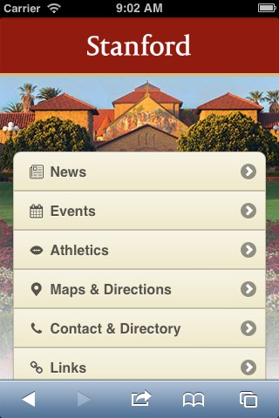
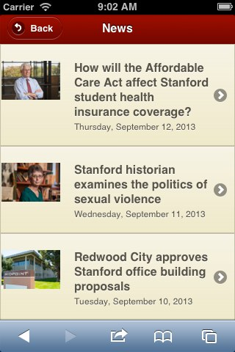
jQuery Mobile: Make it portable and UI friendly

Slide 5
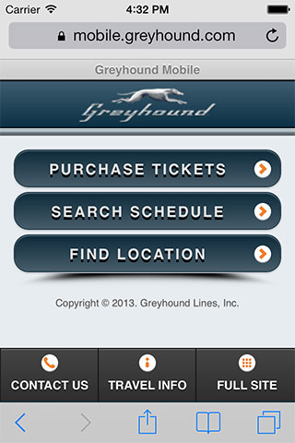
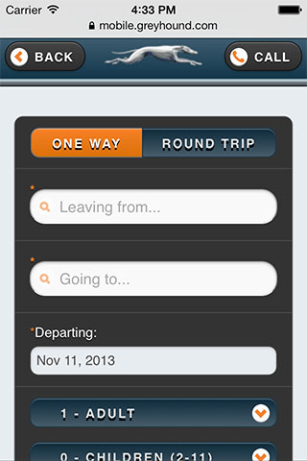
jQuery Mobile: Make it portable and UI friendly
And the world famous: http://kurt-jquerymobile.azurewebsites.net/

Slide 6
jQuery Mobile
jQuery mobile uses HTML5 extensively so need:
<!DOCTYPE html>
load the jQuery mobile framework in head section. We’ll use the CDN enabled links for better performance.
<link rel="stylesheet" type="text/css" href="http://code.jquery.com/mobile/1.3.1/jquery.mobile-1.3.1.min.css"/>
<script src="http://code.jquery.com/jquery-1.8.2.min.js"></script>
Note this PPT reflects ver 1.3.1, an old version. When we get to actually using it for our first demo project, we will use a more current version.

Slide 7
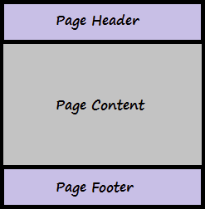
jQuery Mobile : body of the page
The page structure of jQuery mobile app has 3 sections "Header", "Content" and "Footer". They are all simple <div> containers, styled by using the HTML 5 data-role attributes.
As a SPA (single page application), our one downloaded HTML file can contain multiple “pages”, but these pages are really multiple, different page “blocks”, where pages are nothing but <div> elements with other HTML 5 data attributes.
<div data-role="page">
<div data-role="page">
<div data-role="page">
<div data-role="header">
“home/ display data page”
“edit data page”
“delete data page”
<div data-role=“content">
<div data-role=“footer">

Slide 8
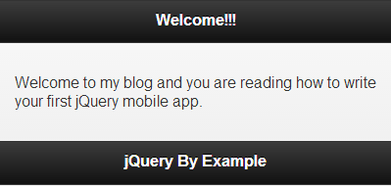
Each “page” has its 3 parts
<!DOCTYPE html>
<html>
<head>
<meta name="viewport" content="width=device-width, initial-scale=1">
<title>My First jQuery Mobile Application</title>
<link rel="stylesheet" type="text/css" href="http://code.jquery.com/mobile/1.3.1/jquery.mobile-1.3.1.min.css"/>
<script src="http://code.jquery.com/jquery-1.8.2.min.js"> </script>
<script src="http://code.jquery.com/mobile/1.3.1/jquery.mobile-1.3.1.min.js"></script>
</head>
<body>
<div data-role="page">
<div data-role="header">
<h1>Welcome!!!</h1>
</div>
<div data-role="content">
<p>Welcome to my blog and you are reading how to write your first jQuery mobile app.</p>
</div>
<div data-role="footer">
<h1>jQuery By Example</h1>
</div>
</div>
</body>
</html>

Slide 9
Theme’s, icons
Has built in 5 themes, sets of consistent shapes, colors, etc.
Just add:
<div data-role="header" data-theme='b'>
As well as buttons with icons:
<a href="Home.html" data-icon="home">Home</a>
That will be a button with a unique icon that takes you to a page called Home
And you can define your own themes
See this site where you can instantly play around with it and see results:
http://jsbin.com/ORiREzu/11/edit?html,output

Slide 10
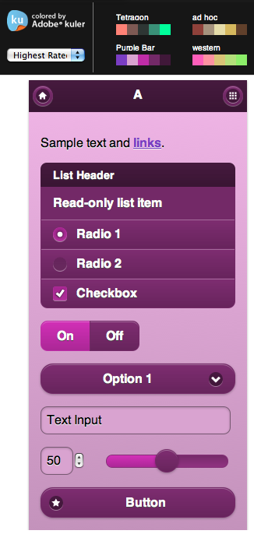
jquery mobile theme roller
https://learn.jquery.com/jquery-mobile/theme-roller/

Slide 11
But
“Things” behave a bit different because all your code is going through the jQuery mobile framework JavaScript engine.
When running a jQuery app, hitting the “back” button on your browser gives bad results.

